Slide 1
AP Statistics Review
Inference for Means and
Errors

Slide 2
Stoney Pryor
Husband for 16 years, father of 3
Teacher in CSISD for 17 years
Taught AP Statistics since 1998
About 110 in 4 sections this year.
Varsity football coach for 14 years, including 3 years as offensive coordinator
Head girls soccer coach since 1999.

Slide 3
The t distribution
In order to conduct a hypothesis test or write a confidence interval for a population mean, a standard deviation (σ) must be known. Since it is not reasonable to know the standard deviation of the population, the standard deviation of the sample, s, is used in its place. When William Gossett investigated the shape of the sampling distribution of the sample means using the sample standard deviation, he found more variability in the tails of the distribution than in a normal model. He also found that increasing the sample size decreased the variability of the distribution. From his work we have the student t-distribution to use as the model when the standard deviation of the population is not known.

Slide 4
The t distribution - Simplified
(σ) replaced with s
William Gossett
more variability in the tails
increasing n decreases the variability
the student t-distribution

Slide 5
The t distribution
Properties of the t-distribution
  a. Has a mean of zero
  b. Is symmetric and bell-shaped
  c. Has more area in the tails than the standard normal distribution
  d. Has a different variance for each different degrees of freedom, where degrees of freedom = sample size minus 1. (df = n-1)
  e. The larger the degree of freedom, the more the graph resembles the standard normal distribution.

Slide 6
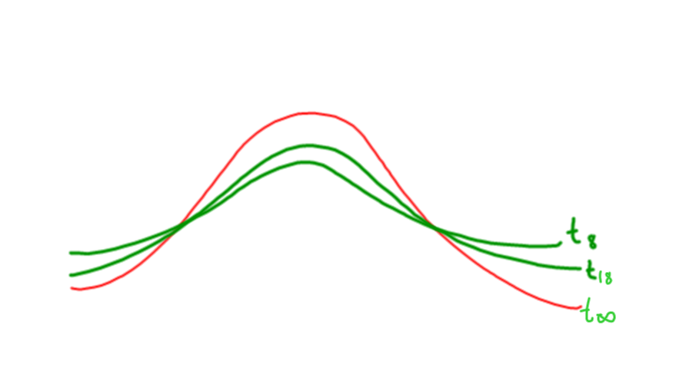

Slide 7
The Big Idea
There are 4 parts to solving a hypothesis test for means
  Set up (state the hypotheses)
  Check the conditions
  Do the “math”
  Conclusions in context

Slide 8
Hypothesis Test for a Population Mean μ
Formulate the hypotheses to be tested.
a. The Null Hypothesis (H_{O}) – a statement describing the believed value of a population mean. This is the statement of no change or no difference.
b. The Alternative Hypothesis (H_{A}) – an inequality describing the value of that same population mean. Usually this is the statement that the test is trying to provide evidence to support. This never includes an =.

Slide 9
Refresh Example
Suppose we wish to test whether a new soft drink “Refresh” contains the 355 ml as shown on the label. Some recently purchased cans seemed under filled. (And we wouldn’t care if they were over filled.) The hypotheses for this test are:
H_{O}: μ = 355 ml
H_{A}: μ < 355 ml , where μ is the true mean content of the “Refresh” cans.

Slide 10
Hypothesis Test for a Population Mean
Identify the appropriate test and verify that the conditions for that test are reasonably satisfied.
-The name of the test here is the one-sample t-test for a mean.
-The conditions that must be satisfied to use the test are that the data was obtained randomly from a normal population.
-The randomization condition is satisfied if a random sample was used to obtain the data or if random assignment was used in an experiment.

Slide 11
Check the conditions, continued
The normal population condition may be difficult to satisfy. In practice, we rely on the sample size and the graph of the data.
  n < 15 ➔ the graph of the data can show no outliers or skewness
  15 < n < 40 ➔ the graph can show no outliers or extreme skewness.
  n > 40 or more ➔ there are no restrictions on the data.

Slide 12
Refresh Example continued
Ideally, cans of “Refresh” should be selected at random from the population of all such cans. Due to the cost involved, a reasonable sample size should be selected and a graph of the data, like a boxplot, must be examined to check for skewness and outliers.
If you worked for Refresh, what sample size would you recommend?

Slide 13
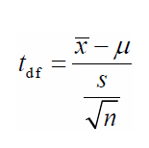
Calculations
Calculate the value of the test statistic and find the p-value. The test statistic for the t-test is
where is the sample mean and s is the sample standard deviation. The p-value is the probability of obtaining the sample statistic or something more extreme given that the null hypothesis is true. In other words it is a conditional probability.

Slide 14
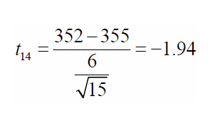
Refresh example continued
Suppose the mean of 15 randomly chosen “Refresh” cans is 352 ml with a standard deviation of 6 ml. Then the test statistic is
The p-value = P(xbar ≤ 352 | μ = 355) = P(t ≤ −1.94) = 0.0366 . There is a 3.66% chance of obtaining a mean of 352 ml or less if the true mean is 355.

Slide 15
Conclusion (in context!)
Write a conclusion with two parts.
The first part rejects or fails to reject the null hypothesis. The decision is made based on the p-value and the desired significance level (alpha level) of the test. If the p-value is less than the alpha level (α ), the null hypothesis is rejected. If the p-value exceeds α , the null hypothesis is not rejected. If the values are equal, no decision is made.
The second conclusion states the results in the context of the question. If the null hypothesis is rejected, there is evidence to support the alternative hypothesis. If the null hypothesis is not being rejected, there is no evidence to support the alternative hypothesis.

Slide 16
Refresh Example Continued
If α = 0 .05, then a p-value of 0.0366 is smaller than α , so H_{O} will be rejected. There is evidence that the mean amount of “Refresh” in the cans is less than the advertised 355 ml. If α = 0.01, then
we fail to reject H_{O}. There is no evidence that the mean amount of “Refresh” in the cans is less than 355 ml.

Slide 17
Errors in Hypothesis Testing
Type I error – incorrectly rejecting a true null hypothesis. Making this type of error is similar to finding an innocent person guilty in a jury trial.
P(Type I error) = α , the significance level of the test.
Type II error – failing to reject a false null hypothesis (incorrectly rejecting a true alternative hypothesis). Making this error is similar to finding a guilty person innocent in a jury trial.

Slide 18
Power
Power – the probability of correctly rejecting a false null hypothesis in favor of a particular true alternative.
P(Type II error) = β
Power = 1- β
The calculation of β and the power depend on the value of the true alternative.
The course description does not include these calculations but an investigative task question might incorporate this concept.

Slide 19
Refresh Example Continued
A Type I error occurs if the results of the hypothesis test suggest that the “Refresh” cans are being under filled, but they really aren’t.
A possible consequence is that the company can be incorrectly accused of false advertising.
A Type II error occurs if the results of the test suggest that the “Refresh” cans are not being under filled but they really are.
A possible consequence is that the company continues to sell a product that is falsely advertised. Consumers get less than they are paying for. The power is the probability that the results of the test show that the true mean content of the cans is not 355 ml but is some smaller value.

Slide 20
Increasing the Power of a Test
• Increase the sample size n
• Increase the probability of making a Type I error α
• Increase the distance between the hypothesized parameter and the true alternative value.

Slide 21
Refresh Example Continued
The diagram below illustrates the relationship
between the chances of making a Type I error, making a Type II error, and the power of the “Refresh” hypothesis test.
If the sample size is increased the two curves will overlap less because the standard error will be smaller, thus increasing the power.
If α is increased, then the decision line for the test will move right in this case and increase the power.
Increasing the distance between 355 and the true alternative mean moves the left curve farther left, increasing the power.

Slide 22
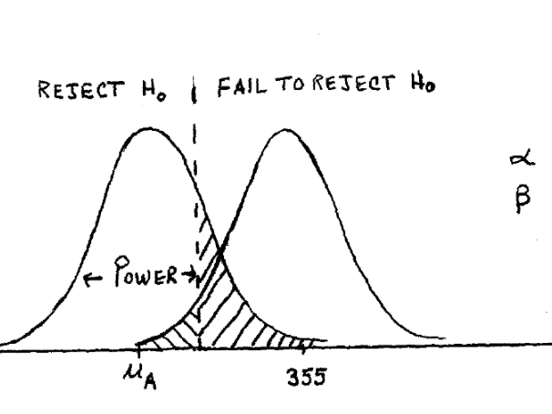

Slide 23
Power applet
http://wise.cgu.edu/power_applet/power.asp
Power video
http://www.youtube.com/watch?v=9lyCnLznAfs

Slide 24
Use the following to answer questions 1 and 2.
A city representative claims that the policemen in the city earn an average of $52,000 per year. The local paper believes that the mean salary is less for the beat cops. A survey conducted by the paper selected a random sample of 20 beat cops and found a mean salary of $51,300 with a standard deviation of $1900. Assume the normality for the
population of the salaries of beat cops is reasonable so a t-test can be conducted using the data.

Slide 25
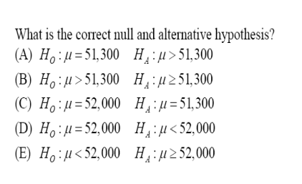
Question 1

Slide 26
Question 1 - Answer
D. Ho: µ = $52,000 and Ha: µ < $52,000
$52,000 is the hypothesized mean. The alternative hypothesis asserts this value
should be smaller.

Slide 27
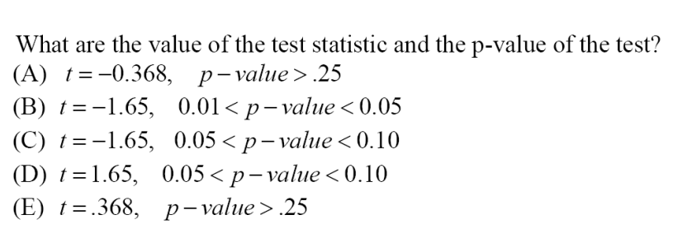
Question 2

Slide 28
Question 2 - Answer

Slide 29
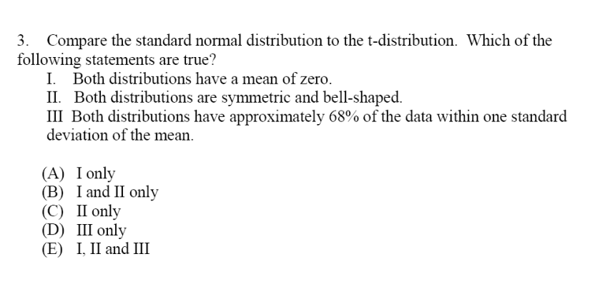
Question 3

Slide 30
Question 3 - Answer

Slide 31
Use the following to answer questions 4 and 5.
A particular tire manufacturer recommends 32 pounds per square inch (psi) of pressure for its passenger car tires. Two independent car driving associations A and B wanted to conduct a two-tailed t-test of whether tire owners are really keeping the tires at the recommended pressure. Association A chooses a random sample of 18 owners. Association B chose a random sample of 30 owners. Plots of both samples showed no skewness or outliers. Surprisingly, both sets of data yielded a mean of 33 psi and standard deviation of 3 psi.

Slide 32
Question 4
Which of the following hypotheses are used in the t-test by each association?
(A) The null hypothesis is that the mean pressure on the tires is less than 32 psi.
(B) The null hypothesis is that the mean pressure on the tires in not 32 psi.
(C) The alternative hypothesis is that the mean tire pressure is greater than 32 psi.
(D) The alternative hypothesis is that the mean tire pressure is less than 32 psi.
(E) The alternative hypothesis is that the mean tire pressure is not 32 psi.

Slide 33
Question 4 - Answer
Which of the following hypotheses are used in the t-test by each association?
(E) The alternative hypothesis is that the mean tire pressure is not 32 psi.
These are two-tailed tests so the alternative hypothesis must state not equals.

Slide 34
Question 5
Which of the following is a true statement about the results of the tests at the 5% level of significance?
(A) Neither test led to a rejection of the null hypothesis.
(B) Both tests led to a rejection of the null hypothesis.
(C) Only Association B’s test led to a rejection of the null hypothesis.
(D) Only Association A’s test led to rejection of the null hypothesis.
(E) Both tests had the same p-value.

Slide 35
Question 5 - Answer
Which of the following is a true statement about the results of the tests at the 5% level of significance?
Neither test led to a rejection of the null hypothesis.
The p-value for Association A’s test is 0.17. The p-value for Association B’s test is 0.078. Both are greater than the given alpha.

Slide 36
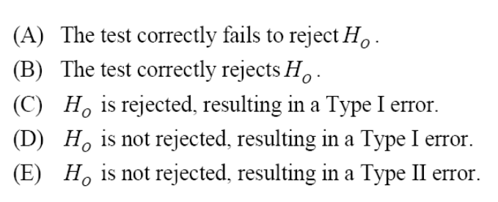
Question 6
Suppose a machine, that makes pegs to be used in holes to hold furniture parts together, is malfunctioning, but the manufacturer doesn’t know it. A quality control test is conducted bimonthly with the null hypothesis stating that the machine works properly. The p-value of the most recent test was 0.185. What probably happens as a result of this test?

Slide 37
Question 6 - Answer
Suppose a machine, that makes pegs to be used in holes to hold furniture parts together, is malfunctioning, but the manufacturer doesn’t know it. A quality control test is conducted bimonthly with the null hypothesis stating that the machine works properly. The p-value of the most recent test was 0.185. What probably happens as a result of this test?

Slide 38
Question 6 - Answer
Suppose a machine, that makes pegs to be used in holes to hold furniture parts together, is malfunctioning, but the manufacturer doesn’t know it. A quality control test is conducted bimonthly with the null hypothesis stating that the machine works properly. The p-value of the most recent test was 0.185. What probably happens as a result of this test?

Slide 39
Question 6 - Answer
Suppose a machine, that makes pegs to be used in holes to hold furniture parts together, is malfunctioning, but the manufacturer doesn’t know it. A quality control test is conducted bimonthly with the null hypothesis stating that the machine works properly. The p-value of the most recent test was 0.185. What probably happens as a result of this test?

Slide 40
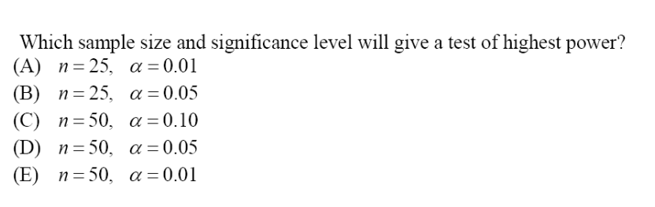
Question 7

Slide 41
Question 7 - Answer

Slide 42
Question 7 - Answer

Slide 43
Question 8
Which of the following statements are false concerning Type I and Type II errors?
I. A Type I error is always worse than a Type II error
II. The higher the probability of a Type I error the lower the probability of a Type II error.
III. A Type I error incorrectly rejects a true alternative hypothesis.
(A) I only
(B) II only
(C) III only
(D) I and III only
(E) II and III only

Slide 44
Question 8 - Answer
Which of the following statements are false concerning Type I and Type II errors?
I. A Type I error is always worse than a Type II error NOT ALWAYS
II. The higher the probability of a Type I error the lower the probability of a Type II error.
III. A Type I error incorrectly rejects a true alternative hypothesis.
(A) I only
(B) II only
(C) III only
(D) I and III only
(E) II and III only

Slide 45
Question 8 - Answer
Which of the following statements are false concerning Type I and Type II errors?
I. A Type I error is always worse than a Type II error NOT ALWAYS
II. The higher the probability of a Type I error the lower the probability of a Type II error. YES! α goes up as β goes down
III. A Type I error incorrectly rejects a true alternative hypothesis.
(A) I only
(B) II only
(C) III only
(D) I and III only
(E) II and III only

Slide 46
Question 8 - Answer
Which of the following statements are false concerning Type I and Type II errors?
I. A Type I error is always worse than a Type II error NOT ALWAYS
II. The higher the probability of a Type I error the lower the probability of a Type II error. YES! α goes up as β goes down
III. A Type I error incorrectly rejects a true alternative hypothesis. NO! We reject (or fail to reject) H_{O}, not H_{A}.
(A) I only
(B) II only
(C) III only
(D) I and III only
(E) II and III only

Slide 47
Question 8 - Answer
Which of the following statements are false concerning Type I and Type II errors?
I. A Type I error is always worse than a Type II error NOT ALWAYS
II. The higher the probability of a Type I error the lower the probability of a Type II error. YES! α goes up as β goes down
III. A Type I error incorrectly rejects a true alternative hypothesis. NO! We reject (or fail to reject) H_{O}, not H_{A}.
(A) I only
(B) II only
(C) III only
(D) I and III only
(E) II and III only

Slide 48
Question 8 - Answer
Which of the following statements are false concerning Type I and Type II errors?
I. A Type I error is always worse than a Type II error NOT ALWAYS
II. The higher the probability of a Type I error the lower the probability of a Type II error. YES! α goes up as β goes down
III. A Type I error incorrectly rejects a true alternative hypothesis. NO! We reject (or fail to reject) H_{O}, not H_{A}.
(A) I only
(B) II only
(C) III only
(D) I and III only
(E) II and III only

Slide 49
Question 9
A t-test should not be used to conduct a hypothesis test for a mean if which of the following is true?
(A) The sample size was only 20.
(B) The standard deviation of the population was unknown.
(C) The data was obtained by random sampling.
(D) A histogram of the data was strongly skewed left.
(E) A boxplot of the data showed no outliers.

Slide 50
Question 9 - Revised
Assume each of the following statements is true. Which one makes you think a t-test should not be used to conduct a hypothesis test for a mean if which of the following is true?
(A) The sample size was only 20.
(B) The standard deviation of the population was unknown.
(C) The data was obtained by random sampling.
(D) A histogram of the data was strongly skewed left.
(E) A boxplot of the data showed no outliers.

Slide 51
Question 9 – Revised - Answer
Assume each of the following statements is true. Which one makes you think a t-test should not be used to conduct a hypothesis test for a mean if which of the following is true?
(A) The sample size was only 20.
(B) The standard deviation of the population was unknown.
(C) The data was obtained by random sampling.
(D) A histogram of the data was strongly skewed left.
(E) A boxplot of the data showed no outliers.

Slide 52
Question 10
Which of the following is the correct interpretation of a p-value of 0.003?
(A) The probability of seeing the observed statistic or something more extreme, if the alternative hypothesis is true, is 0.003.
(B) The probability of seeing the observed statistic or something more extreme, if the null hypothesis is true, is 0.003.
(C) The probability of failing to reject the null hypothesis is 0.003.
(D) The probability that the null hypothesis is true is 0.003.
(E) The probability that the alternative hypothesis true is 0.003.

Slide 53
Question 10 - Answer
Which of the following is the correct interpretation of a p-value of 0.003?
(B) The probability of seeing the observed statistic or something more extreme, if the null hypothesis is true, is 0.003.

Slide 54
Free Response #1
An English professor at a local community college is disappointed that the average score on the final exam in her previous Freshman Survey courses has been 78. A friend who is a computer professor suggests that she set up a website containing tutorials created by a local actor and require students to log on for a weekly presentation. There would be no charge for the first semester of the program, but thereafter students would have to pay an extra $50 to enroll in the course. The English professor decides to give the tutorials a try for one semester for a random sample of her students.
Define the parameter of interest and state the null and alternative hypothesis that the English professor is testing.
(b) In the context of the problem, describe a Type I error and the possible consequences to the students.
(c) In the context of the problem, describe a Type II error and the possible consequences to the students.

Slide 55
Free Response #1 - Answer
Part (a)
Ho: µ = 78
Ha: µ > 78 where μ is the true mean final exam score for internet students
Part (b)
A Type I error results if the teacher believes that the final exam score has increased when it really hasn’t. The following semester students will have to pay extra and waste time on an ineffectual program.
Part (c)
A Type II error results if the teacher believes that the final exam score has not increased when it really has. The following semester students will miss out on the opportunity to achieve a higher grade in the professor’s class.

Slide 56
Free Response #2
An AP Statistics student enjoys eating ChocoChewys, a new chewy candy bar with peanuts, caramel, and chocolate that comes in 1.45 oz. sealed packaging. He begins questioning the quality control of the candy maker when he gets a bar that is much smaller than he expected. He decides to buy 10 ChocoChewys at 10 randomly chosen grocery stores in his city and conduct a hypothesis test that he learned about in class. He weighs each bar with a digital scale that is accurate to a thousandth of an ounce.

Slide 57
Free Response #2
ChocoChew Bar | 1 | 2 | 3 | 4 | 5
Weight (oz) | 1.432 | 1.471 | 1.406 | 1.443 | 1.469
ChocoChew Bar | 6 | 7 | 8 | 9 | 10
Weight (oz) | 1.398 | 1.439 | 1.458 | 1.448 | 1.429
Based on the data that he obtains, is there evidence that the candy maker needs to check his quality control process?
Interpret the p-value in the context of the problem.

Slide 58
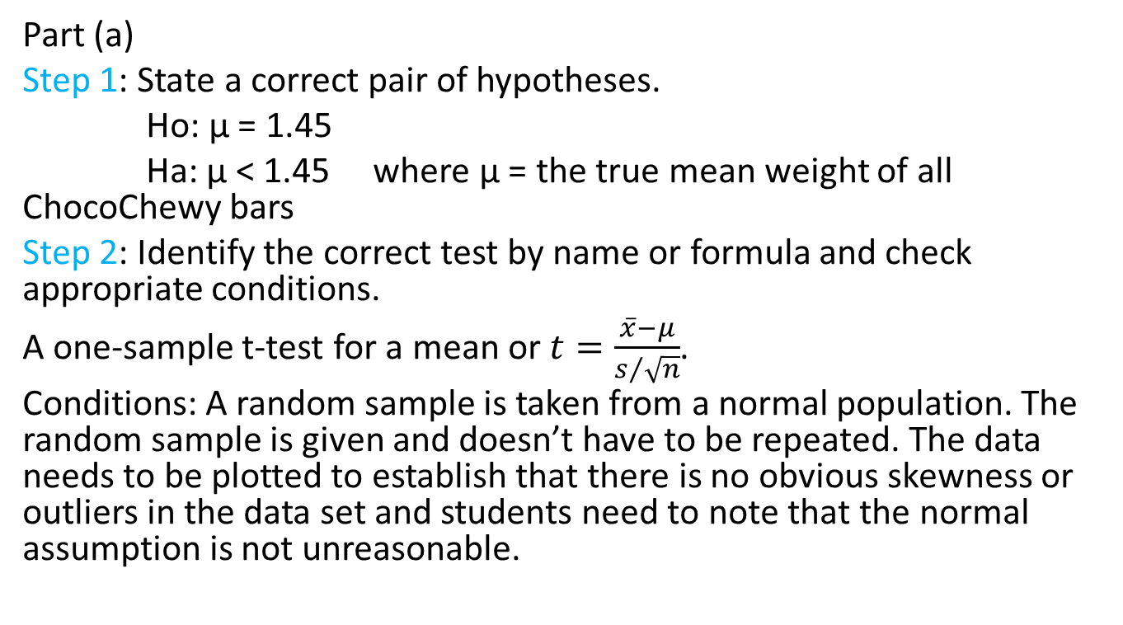
Free Response #2 - Answer
Part (a)
Step 1: State a correct pair of hypotheses.
Ho: µ = 1.45
Ha: µ < 1.45 where μ = the true mean weight of all ChocoChewy bars
Step 2: Identify the correct test by name or formula and check appropriate conditions.
A one-sample t-test for a mean or $t=\frac{\overline{x}−μ}{s/{\sqrt{n}}}$.
Conditions: A random sample is taken from a normal population. The random sample is given and doesn’t have to be repeated. The data needs to be plotted to establish that there is no obvious skewness or outliers in the data set and students need to note that the normal assumption is not unreasonable.

Slide 59
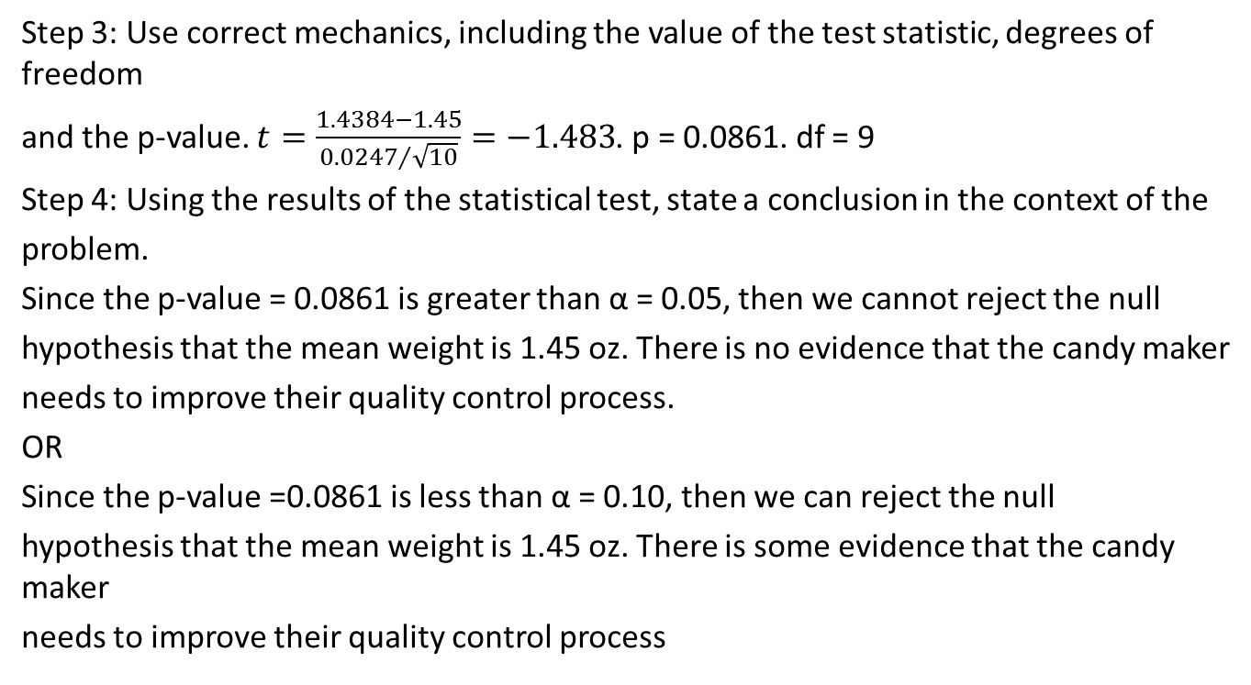
Free Response #2 - Answer
Step 3: Use correct mechanics, including the value of the test statistic, degrees of freedom
and the p-value. $t=\frac{1.4384−1.45}{{0.0247}/{\sqrt{10}}}=−1.483$. p = 0.0861. df = 9
Step 4: Using the results of the statistical test, state a conclusion in the context of the
problem.
Since the p-value = 0.0861 is greater than α = 0.05, then we cannot reject the null
hypothesis that the mean weight is 1.45 oz. There is no evidence that the candy maker
needs to improve their quality control process.
OR
Since the p-value =0.0861 is less than α = 0.10, then we can reject the null
hypothesis that the mean weight is 1.45 oz. There is some evidence that the candy maker
needs to improve their quality control process

Slide 60
Free Response #2 – finer points
If both an α and a p-value are given, the linkage is implied. If no α is given, the solution must explain how the conclusion follows from the p-value.
If the p-value is incorrect in step 3, but the conclusion is consistent with the computed p-value, step 4 is considered as correct.

Slide 61
Free Response #2 - Answer
Part (b)
The p-value = 0.0861 describes the probability that the sample mean of 1.438 oz or some smaller value could have occurred by chance given that the true mean weight of the candy is 1.45 oz.
OR
If the mean weight of the candy bars had not decreased, we could expect to find a weight of at most 1.438 ounces 8.61% of the time.

Slide 62
Free Response #3
Joey, a soccer player, wants to improve his kicking accuracy so he can be the primary team member to do corner kicks. After watching David Beckham videos and practicing all summer, he tells his select soccer coach he can now get 75% of his corner kicks into the goal. He had only been 50% accurate the year before. The coach decides to let Joey take 12 practice corner kicks. If he can get at least 10 of them in the goal, the coach will make him the primary corner kicker.

Slide 63
Corner kick videos
http://www.youtube.com/watch?v=UKwnnYIxk8g (go to 0:20)
http://www.youtube.com/watch?v=wt-XTr22C4Y

Slide 64
Free Response #3
(a) Suppose Joey really didn’t improve – he still gets 50% of his corner kicks in the goal. If we assume that each of his kicks is independent of each other, what is the probability that he can make at least 10 goals on the 12 practice kicks?
(b) Suppose Joey didn’t improve but does make at least 10 goals on the 12 kicks. If a hypothesis test associated with this situation has a significance level of 0.05, what type of error does the coach make? Explain

Slide 65
Free Response #3
(c) If Joey really can make 75% of the goals and the coach insists on his making at least 10 out of the 12 goals to prove it, define the power associated with this hypothesis test and find its value.
(d) Based on the results in part c, is this considered a powerful test? If yes, explain why?
If no, explain how to improve the power of the test?

Slide 66
Mountain Lions
How much do wild mountain lions weigh? The 77th Annual Report of the New Mexico Department of Game and Fish, edited by Bill Montoya, gave the following information. Adult mountain lions captured and released for the first time in the San Andres Mountains gave the following weights (lbs.):
Find a 95% confidence interval for the true average weight of a mountain lion.
68 | 104 | 128 | 122 | 60 | 64
Notes:
Taken from Understandable Statistics, Brase & Brase, p401, question 9.

Slide 67
Minitab Output
T Confidence Intervals
Variable N Mean StDev SE Mean 95.0 % CI
Lion Wt 6 91.0 30.7 12.5 ( 58.8, 123.2)

Slide 68
Mountain Lions
Suppose that 5 years ago the weight of an adult mountain lion was 100 lbs. Since that time, there has been somewhat of a drought in New Mexico and numerous forest fires, possibly depleting food sources for the lions. Is there evidence from the data that the mean weight has decreased?

Slide 69
More Minitab Output
T-Test of the Mean
Test of mu = 100.0 vs mu < 100.0
Variable N Mean StDev SE Mean T P
Lion Wt 6 91.0 30.7 12.5 -0.72 0.25

Slide 70
Fast Food French Fries
How many calories are there in 3 ounces of french fries? It depends on where you go to get them. Good Cholesterol Bad Cholesterol, by Roth and Streicher, gives the data from 8 popular fast-food restaurants. The data are (in calories)
Find a 95% confidence interval for the true mean caloric content in 3 ounces of fast food french fries.
222 | 255 | 254 | 230 | 249 | 222 | 237 | 287

Slide 71
Minitab Output
T Confidence Intervals
Variable N Mean StDev SE Mean 95.0 % CI
Fries 8 244.50 21.73 7.68 (226.32, 262.68)

Slide 72
More fast fries
Suppose that 10 years ago the mean number of calories in 3 ounces of french fries from all fast food places was 260. Since that time, there has been considerable "health talk." Is there evidence from the data that the mean number of calories has decreased? Answer this question by performing an appropriate test of significance.

Slide 73
More minitab
T-Test of the Mean
Test of mu = 260.00 vs mu < 260.00
Variable N Mean StDev SE Mean T P
Fries 8 244.50 21.73 7.68 -2.02 0.042

Slide 74
Rowing
What aspects of rowing technique distinguish novice and skilled competitive rowers? Researchers compared two groups of female competitive rowers: a group of skilled rowers and a group of novices. The researchers measured many mechanical aspects of rowing style as the subjects rowed on a Stanford Rowing Ergometer. One important variable is the angular velocity of the knee, which describes the rate at which the knee joint opens as the legs push the body back on the gliding seat. The data show no outliers or strong skewness. Here is the SAS computer output.

Slide 75
SAS Output
TTEST PROCEDURE
Variable: KNEE
Is knee velocity higher for skilled rowers?
Give a 95% confidence interval for the mean difference between the knee velocities of skilled and novice rowers.
GROUP | N | Mean | Std Dev | Std Error
SKILLED | 10 | 4.18283335 | 0.47905935 | 0.15149187
NOVICE | 8 | 3.01000000 | 0.95894830 | 0.33903942
Variances | T | DF | Prob > |T|
Unequal | 3.1583 | 9.8 | 0.0104
Equal | 3.3918 | 16.0 | 0.0037

Slide 76
7th grade self concept
Here is SAS output for a study of the self-concept of seventh grade students. The variable SC is the score on the Piers-Harris Self Concept Scale.
The researchers wished to determine if males and female students differ in mean self-concept scores.

Slide 77
SAS on Self Concept
TTEST PROCEDURE
Variable: SC
SEX | N | Mean | Std Dev | Std Error
F | 31 | 55.51612903 | 12.69611743 | 2.28029001
M | 47 | 57.91489362 | 12.26488410 | 1.78901722
Variances | T | DF | Prob > |T|
Unequal | -0.8276 | 62.8 | 0.4110
Equal | -0.8336 | 76.0 | 0.4071

Slide 78
Stoney Pryor
myhistorycoach.com/stat
Youtube: StoneyP94
spryor@csisd.org

